Slide 1
Skills Bootcamp Classroom Rules
Be on time: Just like in a physical classroom, it's important to be punctual for your online class. Log in to the virtual classroom a few minutes before the class starts.
Turn Cameras on: In order to maximise your learning studies show that being able to see your peers and your tutor being able to see you can increase motivations and retention, therefore we ask to keep your cameras on.
Attend all classes: In order to be successful in your bootcamp studies you need to attend all live sessions, therefore you should prioritise and make time for these sessions.
Avoid distractions: Turn off your phone notifications, close any other unnecessary tabs, and focus solely on the class.
Participate actively: It's important to be an active participant in the class. Ask questions, answer questions, and participate in discussions.
Use proper language and tone: Use respectful language and tone when communicating with your classmates and instructor. Avoid using slang or inappropriate language.
Respect others' opinions: Be respectful of others' opinions, even if they differ from your own. Avoid making negative comments or attacking others.
Follow the instructor's guidelines: Follow the instructor's guidelines, such as submitting assignments on time.
Be polite: Be polite and respectful to everyone in the class, including the instructor, classmates, and guest speakers.
Dress appropriately: Even though you are not in a physical classroom, it's important to dress appropriately. Dress as if you were going to a face-to-face class.
Use appropriate technology: Ensure that you have the necessary equipment, such as a reliable internet connection, a microphone, and a webcam, and that they are in good working condition.

Slide 2
Software Developer Bootcamp
Unit 1 – Introduction to Software Development
Week 1C
Notes:
Good morning/afternoon everyone. Today we'll delve into the role of software in various industries, understand their primary purposes, and classify them based on their target audiences.

Slide 3
Learning Outcomes
Identify the key types of data each identified industry relies on.
Explain how data security considerations may differ among the industries.
Assess how the volume of data can affect software development decisions.
Describe how compliance and regulations influence software development in each industry.
Articulate how customer needs can influence the rationale for software development in different industries.
Evaluate the role of innovation and competition in shaping software development rationale in one selected industry.

Slide 4

Key Types of Data in Different Industries
Healthcare: Beyond records - telemedicine data, genome databases, AI diagnostic tools. Finance: Beyond transactions - predictive analysis data, algorithmic trading patterns, customer risk profiles. Retail: Beyond sales - customer online behaviour, predictive restocking, AI-driven recommendation systems.
Notes:
We aim to provide an understanding of how data impacts software development, from the types of data used to the regulatory landscape that governs its use. Understanding the types of data is the first step in any data-driven initiative. For instance, healthcare often relies on continuous data like patient vitals, while retail focuses on discrete data like the number of sales. Knowing the type of data helps in selecting the right tools and methodologies for analysis.

Slide 5
Activity 1 – Group Discussion (10 mins)
Choose the Entertainment Industry. Discuss the range from streaming habits to virtual reality data sets.
Notes:
A historical overview of security breaches, their consequences, and lessons learned.

Slide 6
Data Security Considerations Among Industries
Healthcare: Beyond confidentiality - ensuring data integrity, ransomware threats. Finance: Beyond transactions - insider trading data monitoring, AI-driven fraud detection. Retail: Beyond payment security - protection of customer behavior data, securing supplier chain communication.
Notes:
Data security is not a one-size-fits-all concept. Each industry has its own set of challenges and requirements. For instance, the finance sector has to comply with stringent regulations like PCI DSS for payment data, while healthcare must adhere to HIPAA for patient records. Emphasise the importance of public trust and the consequences of its loss.

Slide 7
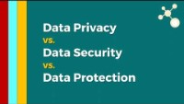
Data Security Considerations Video
Notes:
Emphasise the importance of public trust and the consequences of its loss.

Slide 8
Activity 2 – Pair Work
Deep dive into the Equifax data breach. Discuss implications, public reaction, and post-breach measures.
https://www.cnbc.com/2019/07/22/what-you-need-to-know-equifax-data-breach-700-million-settlement.html
Notes:
Case studies on companies that scaled successfully and those that faced challenges.

Slide 9
Volume of Data and Software Development
The infrastructural challenges: Data centers, cloud migration, latency issues. Software design considerations: Modular designs, microservices, decoupling data from functionality.
Notes:
The volume of data can have a profound impact on software development. For instance, e-commerce giants like Amazon use big data to provide personalised recommendations, requiring robust and scalable software solutions. Similarly, streaming services like Netflix use data analytics to suggest shows, affecting both software and business strategies. Discuss the complexity behind platforms we use daily, from data storage to recommendation algorithms.

Slide 10
Activity 3 – Individual Reflection
Reflect on platforms like YouTube. Consider the petabytes of data uploaded daily and its implications on software architecture.
Notes:
Discuss the fine balance between innovation and regulatory compliance.

Slide 11
Compliance and Regulations in Software Development
GDPR's influence: Not just user data, but also AI decision transparency. HIPAA: Beyond patient data - telemedicine regulations, cross-border data sharing. Financial regulations: Beyond fraud - algorithmic trading oversight, cryptocurrency regulations.
Notes:
The evolution of gaming software regulations, from simple age restrictions to complex data handling mandates.

Slide 12

Compliance and Regulations in Software Development Video
Notes:
Compliance is a critical factor that can dictate the design and functionality of software. For example, if you're developing a healthcare app in the United States, you must ensure it's HIPAA-compliant to protect patient data. Failure to comply can result in hefty fines and reputational damage. The evolution of gaming software regulations, from simple age restrictions to complex data handling mandates.

Slide 13
Activity 4 – Group Activity
Explore the Gaming Industry. From age restrictions to in-game purchases to data privacy.
Notes:
Discuss the constant tug-of-war between business goals and customer satisfaction.

Slide 14
Customer Needs in Software Development
The rise of user-centric design: From software functionality to user experience (UX). Feedback loops: Iterative software development, agile methodologies. Case study: Evolution of messaging apps - SMS to WhatsApp to Signal.
Notes:
Customer needs can vary dramatically from one industry to another. For example, ride-sharing services like Uber use real-time data analytics to match drivers with riders efficiently, while music streaming services like Spotify use data analytics to offer personalised playlists. The iterative nature of software driven by fierce competition and user demands.

Slide 15

Customer Needs in Software Development Video
Notes:
The iterative nature of software, driven by fierce competition and user demands.

Slide 16
Activity 5 – Individual Task
Analyse platforms like Airbnb. Features from user reviews, map integrations, to AI-driven price suggestions.
Notes:
The cyclical nature of innovation and obsolescence in software.

Slide 17
Innovation and Competition in Software Development
Historical context: How competition drove innovation from the PC era to the mobile era. Case study: Browser wars - Netscape to Internet Explorer to Chrome.
Notes:
Innovation is often the differentiating factor in a competitive market. Take Apple, for instance. Its continuous innovation in product design and functionality has kept it ahead of competitors for years. In software development, innovation can come in the form of new features, improved user experience, or even entirely new ways of solving problems. Discuss the underlying business models and how they shape software offerings.

Slide 18
Activity 6 – Group Discussion
Explore the Cloud Storage Industry. The competition among Dropbox, Google Drive, and OneDrive leading to software innovations.
Notes:
Encouragement for learners to stay abreast of both industry trends and software advancements.

Slide 19

Integrated development environments (IDEs)
IDEs were created to give programmers all the tools they needed to write programs in one place.
They allow you to write, run, and debug code without having to switch programs.
They were designed to make programming easier!
Notes:
Image source: https://pixabay.com/photos/tools-vintage-woodworking-saw-1209764/

Slide 20
Integrated development environments (IDEs)
Basic text editor
if today_is_cold:
print("Wear a coat")
IDEs make it easier to write code because they provide useful tools, like syntax colour coding.
IDE example
if today_is_cold:
print("Wear a coat")

Slide 21
Integrated development environments (IDEs)
Basic text editor
if today_is_cold:
print("Wear a coat")
IDEs can also highlight important syntax structures to remind you to include them.
IDE example
if today_is_cold:
print("Wear a coat")

Slide 22
Integrated development environments (IDEs)
They will often automatically indent code for you.
Python is very particular about indents. The IDE will remind you if it thinks an indent is required by putting one in for you.
Basic text editor
if today_is_cold:
print("Wear a coat")
IDE example
if today_is_cold:
print("Wear a coat")

Slide 23
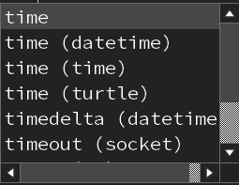
Integrated development environments (IDEs)
Activity 1
Basic text editor
if today_is_cold:
print("Wear a coat")
And they can autocomplete lines of code that are typically used.
IDE example
import tim
if today_is_cold:
print("Wear a coat")

Slide 24
Integrated development environments (IDEs)
In programming, the language specific code that you write in has its own syntax. The syntax is unique to that programming language.
An IDE can point out any syntax errors that you have made. This means that you can then check and fix them.
IDE example
if today_is_cold:
print"Wear a coat")
Error message
line 2
print"Wear a coat")
^
SyntaxError: invalid syntax
>>>

Slide 25
Integrated development environments (IDEs)
In Python, the IDE will call the interpreter to translate the code and allow you to run and test your program.
This means that you can test your code as you write your program.
IDE example
print("What is your name?")
name = input()
print("Hello", name)
Runtime output
What is your name?
Becky
Hello Becky
>>>

Slide 26
Integrated development environments (IDEs)
Without an IDE, you would have to write all of your programs in a basic text editor.
You would then need to switch programs to translate the code and test it. An IDE helps programmers because it bundles together these processes.
Basic text editor
if today_is_cold:
print("Wear a coat")

Slide 27
Question
if today_is_cold:
print"Wear a coat")
How many features of an IDE can you spot in this diagram?
line 2
print"Wear a coat")
^
SyntaxError: invalid syntax
>>>

Slide 28
Question
Syntax colour coding
if today_is_cold:
print"Wear a coat")
Syntax highlighting
Automatic indents
line 2
print"Wear a coat")
^
SyntaxError: invalid syntax
>>>
Syntax error checking

Slide 29
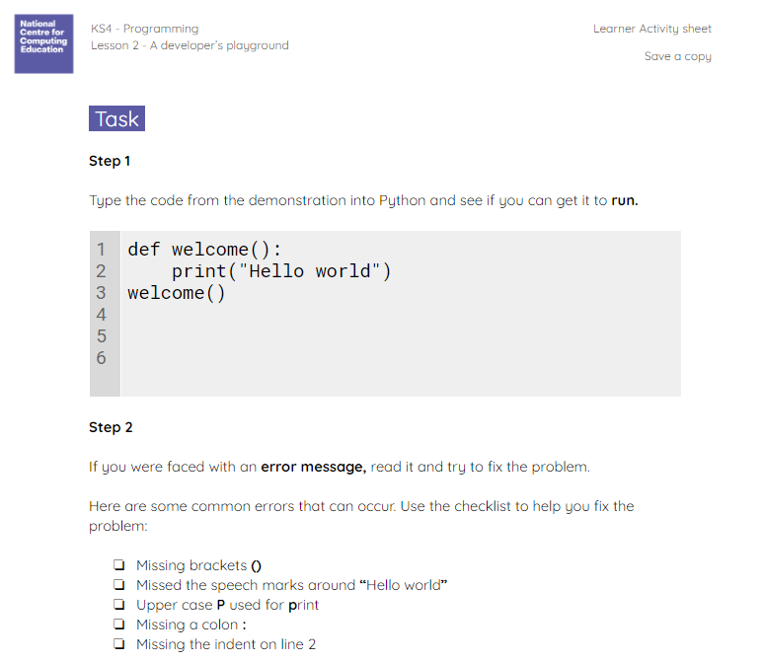
Your first Python code
Use the worksheet to help you write your first piece of Python code.
1
2
3
def welcome():
print("Hello world")
welcome()
Notes:
Share A2 worksheet – Your first Python code with learners

Slide 30

Twinkle, twinkle, little sequence
Precise instructions are very important when programming. You also need to make sure that your code is written in the correct sequence.
A sequence of instructions will be read from top to bottom, performing each instruction in turn.
Notes:
Image source: https://pixabay.com/illustrations/moon-star-night-dream-landscape-4606246/

Slide 31
Twinkle, twinkle, little sequence
A karaoke program has been created to help a class of nursery children remember the words to Twinkle, Twinkle, Little Star.
You will need to investigate the code to see how it works, and then modify it so that it is finished.
Notes:
Image source: https://pixabay.com/illustrations/moon-star-night-dream-landscape-4606246/

Slide 32
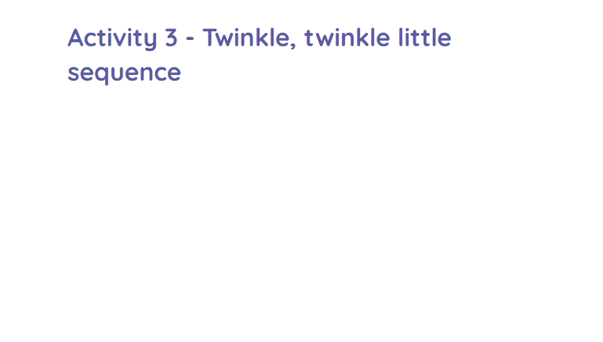
Twinkle, twinkle, little sequence
Use the Activity 3 worksheet to help you do this.
Notes:
Provide learners with: A3 Worksheet – Twinkle, twinkle little sequence

Slide 33
Conclusion
Predictions: Future trends in software development based on emerging industry needs.
Notes:
We've covered a wide range of topics today, from the types of data and their security considerations to the impact of customer needs and innovation on software development. Now, I'd like to open the floor for any questions you may have.

Slide 34
Learning Outcomes
Identify the key types of data each identified industry relies on.
Explain how data security considerations may differ among the industries.
Assess how the volume of data can affect software development decisions.
Describe how compliance and regulations influence software development in each industry.
Articulate how customer needs can influence the rationale for software development in different industries.
Evaluate the role of innovation and competition in shaping software development rationale in one selected industry.

Slide 35
Thank You!
Thank you for your active participation and engagement.
Any Qs

